Slide 1



Dislocation Dynamics (DD) is a new computer simulation method developed at UCLA for modeling fundamental microscopic mechanical properties.
Broad Objectives of DD:
1. Understand fundamental deformation mechanisms
2. Provide a physical basis for polycrystal plasticity
3. Determine stress-strain behavior without assumptions.
4. Design new ultra-strong and super-ductile materials.
(1) N. M. Ghoniem, L. Sun, Phys. Rev. B, 60(1): 128-140 (1999).
(2) N.M. Ghoniem, S.- H. Tong, and L. Z. Sun Phys. Rev. B, 61(1): 913-927 (2000).
TEM-Slice
Notes:
Table of Contents
1. Thermophysical Properties
1. 1 Specific Volume of Sn
1. 2 Density of Sn
1. 3 Volumetric expansion coefficient (γ) of liquid Sn:
1. 4 Compressibility
1. 5 Viscosity:
1. 6 Surface Tension:
1. 7 Vaporization
1. 8 Boiling Point
1. 9 Heat of Sublimation (Ls) and Vaporization (Lv):
1. 10 Critical Pressure (pc), Temperature (Tc), and Volume (Vc)
1. 11 Heat Capacity
1. 12 Electrical Resistivity (ρ) of liquid Sn
2. Thermodynamic Properties of Sn
2. 1 Enthalpy, Specific Heat, and Entropy of Sn-Vapor
2. 2 Heat of Dissociation, Reaction Enthalpy, and Ionization Potentials of Various Tin-Compounds
2. 2. 1 Heat of Dissociation
2. 2. 2 Reaction Enthalpies
2. 2. 3 Ionization Potentials
2. 3 Thermodynamic data of Sn-silicates
2. 3. 1 Specific heat (cp) of Sn-silicates as a function of temperature
2. 4 The Sn-H System
2. 4. 1 Hydrogen Solubility
2. 4. 2 Absorption of Hydrogen
2. 4. 3 H2-Adsorption
2. 4. 4 H2-Diffusion Coefficient
2. 4. 5 Reduction of Sn by atomic hydrogen
2. 4. 6 The SnH and SnD Molecule
2. 4. 7 Solubility of the gas composition H2-CO-CO2
2. 5 The Sn-Li System
2. 5. 1 Formation of Li2SnO3*
Stability of Li2SnO3*
2. 6 The Sn-C System
2. 6. 1 Solubility
2. 6. 2 The Sn-C Molecule
2. 6. 3 The SnCO3 Molecule
2. 7 The Sn-Si System
2. 7. 1 Diffusion of Sn in solid Si
2. 7. 2 The Sn-Si Molecule
2. 8 Sn and Oxygen
2. 8. 1 Low Pressure Oxidation
2. 8. 2 Oxidation Mechanism:
2. 8. 3 Solubility of O in Sn
2. 9 The SnO-SiO2 System
2. 10 General Literature on Corrosion of Sn with Metals:

Slide 2
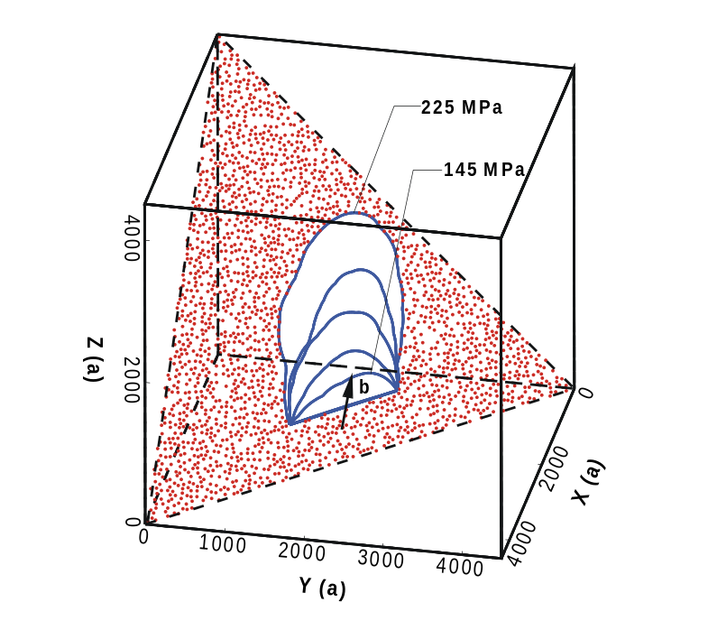
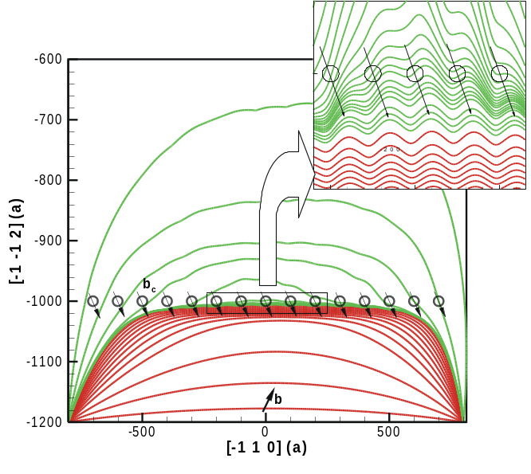
Successful Applications in Fusion Material Science (1)
(1) Mechanisms of dislocation-defect interaction:
Now we understand:
(a) how dislocations destroy vacancy clusters;
(b) how dislocations overcome the resistance of SIA clusters.
Leads to localized flow
(1) N.M. Ghoniem, B. N. Singh, L. Z. Sun, and T. Diaz de la Rubia, J. Nucl. Mater, 276: 166-177 (2000).
(2) N.M. Ghoniem, S.- H. Tong, B.N. Singh, and L. Z. Sun, Phil. Mag., 2001, submitted
Leads to yield drop
Notes:
Table of Contents
1. Thermophysical Properties
1. 1 Specific Volume of Sn
1. 2 Density of Sn
1. 3 Volumetric expansion coefficient (γ) of liquid Sn:
1. 4 Compressibility
1. 5 Viscosity:
1. 6 Surface Tension:
1. 7 Vaporization
1. 8 Boiling Point
1. 9 Heat of Sublimation (Ls) and Vaporization (Lv):
1. 10 Critical Pressure (pc), Temperature (Tc), and Volume (Vc)
1. 11 Heat Capacity
1. 12 Electrical Resistivity (ρ) of liquid Sn
2. Thermodynamic Properties of Sn
2. 1 Enthalpy, Specific Heat, and Entropy of Sn-Vapor
2. 2 Heat of Dissociation, Reaction Enthalpy, and Ionization Potentials of Various Tin-Compounds
2. 2. 1 Heat of Dissociation
2. 2. 2 Reaction Enthalpies
2. 2. 3 Ionization Potentials
2. 3 Thermodynamic data of Sn-silicates
2. 3. 1 Specific heat (cp) of Sn-silicates as a function of temperature
2. 4 The Sn-H System
2. 4. 1 Hydrogen Solubility
2. 4. 2 Absorption of Hydrogen
2. 4. 3 H2-Adsorption
2. 4. 4 H2-Diffusion Coefficient
2. 4. 5 Reduction of Sn by atomic hydrogen
2. 4. 6 The SnH and SnD Molecule
2. 4. 7 Solubility of the gas composition H2-CO-CO2
2. 5 The Sn-Li System
2. 5. 1 Formation of Li2SnO3*
Stability of Li2SnO3*
2. 6 The Sn-C System
2. 6. 1 Solubility
2. 6. 2 The Sn-C Molecule
2. 6. 3 The SnCO3 Molecule
2. 7 The Sn-Si System
2. 7. 1 Diffusion of Sn in solid Si
2. 7. 2 The Sn-Si Molecule
2. 8 Sn and Oxygen
2. 8. 1 Low Pressure Oxidation
2. 8. 2 Oxidation Mechanism:
2. 8. 3 Solubility of O in Sn
2. 9 The SnO-SiO2 System
2. 10 General Literature on Corrosion of Sn with Metals:

Slide 3
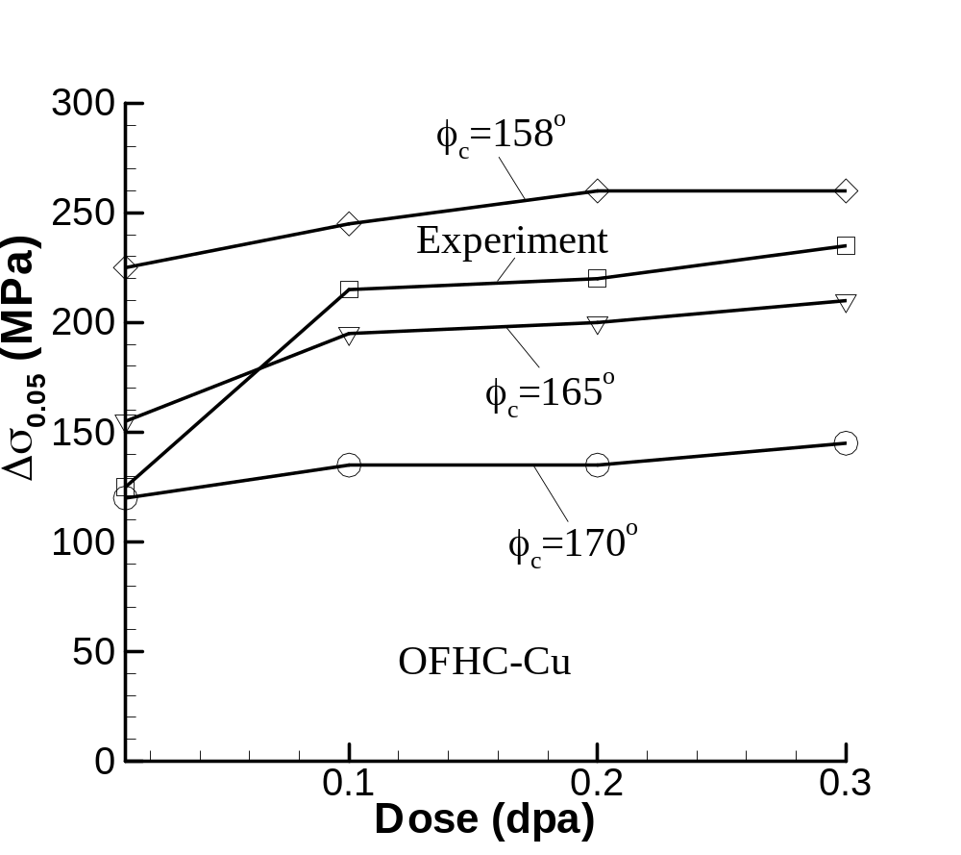
Successful Applications in Fusion Material Science (2)
(2) Quantitative predictions of radiation hardening with only one adjustable parameter.
Measurements at PNNL
(D. Edwards) & Simulations
at UCLA.
Notes:
Table of Contents
1. Thermophysical Properties
1. 1 Specific Volume of Sn
1. 2 Density of Sn
1. 3 Volumetric expansion coefficient (γ) of liquid Sn:
1. 4 Compressibility
1. 5 Viscosity:
1. 6 Surface Tension:
1. 7 Vaporization
1. 8 Boiling Point
1. 9 Heat of Sublimation (Ls) and Vaporization (Lv):
1. 10 Critical Pressure (pc), Temperature (Tc), and Volume (Vc)
1. 11 Heat Capacity
1. 12 Electrical Resistivity (ρ) of liquid Sn
2. Thermodynamic Properties of Sn
2. 1 Enthalpy, Specific Heat, and Entropy of Sn-Vapor
2. 2 Heat of Dissociation, Reaction Enthalpy, and Ionization Potentials of Various Tin-Compounds
2. 2. 1 Heat of Dissociation
2. 2. 2 Reaction Enthalpies
2. 2. 3 Ionization Potentials
2. 3 Thermodynamic data of Sn-silicates
2. 3. 1 Specific heat (cp) of Sn-silicates as a function of temperature
2. 4 The Sn-H System
2. 4. 1 Hydrogen Solubility
2. 4. 2 Absorption of Hydrogen
2. 4. 3 H2-Adsorption
2. 4. 4 H2-Diffusion Coefficient
2. 4. 5 Reduction of Sn by atomic hydrogen
2. 4. 6 The SnH and SnD Molecule
2. 4. 7 Solubility of the gas composition H2-CO-CO2
2. 5 The Sn-Li System
2. 5. 1 Formation of Li2SnO3*
Stability of Li2SnO3*
2. 6 The Sn-C System
2. 6. 1 Solubility
2. 6. 2 The Sn-C Molecule
2. 6. 3 The SnCO3 Molecule
2. 7 The Sn-Si System
2. 7. 1 Diffusion of Sn in solid Si
2. 7. 2 The Sn-Si Molecule
2. 8 Sn and Oxygen
2. 8. 1 Low Pressure Oxidation
2. 8. 2 Oxidation Mechanism:
2. 8. 3 Solubility of O in Sn
2. 9 The SnO-SiO2 System
2. 10 General Literature on Corrosion of Sn with Metals:

Slide 4

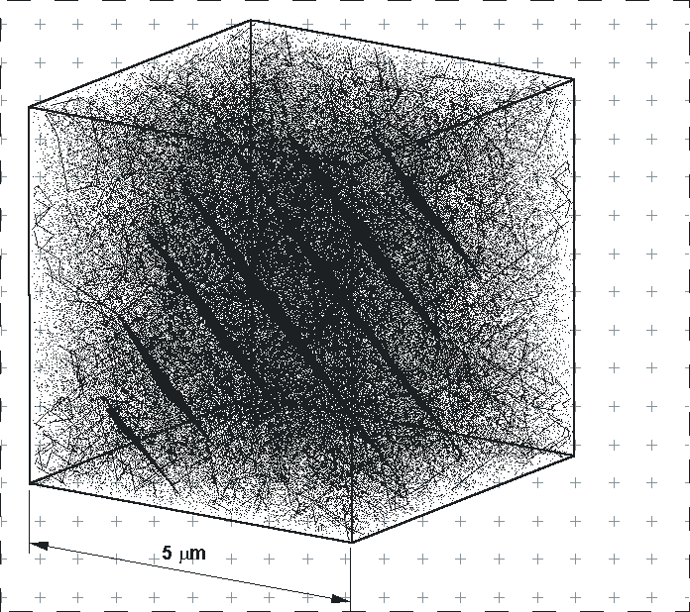
Successful Applications in Fusion Material Science (3)
(3) UCLA-RISO (Denmark)
collaboration on localization of plastic flow.
Computer Simulations
Experiments on Irradiated Cu
Notes:
Table of Contents
1. Thermophysical Properties
1. 1 Specific Volume of Sn
1. 2 Density of Sn
1. 3 Volumetric expansion coefficient (γ) of liquid Sn:
1. 4 Compressibility
1. 5 Viscosity:
1. 6 Surface Tension:
1. 7 Vaporization
1. 8 Boiling Point
1. 9 Heat of Sublimation (Ls) and Vaporization (Lv):
1. 10 Critical Pressure (pc), Temperature (Tc), and Volume (Vc)
1. 11 Heat Capacity
1. 12 Electrical Resistivity (ρ) of liquid Sn
2. Thermodynamic Properties of Sn
2. 1 Enthalpy, Specific Heat, and Entropy of Sn-Vapor
2. 2 Heat of Dissociation, Reaction Enthalpy, and Ionization Potentials of Various Tin-Compounds
2. 2. 1 Heat of Dissociation
2. 2. 2 Reaction Enthalpies
2. 2. 3 Ionization Potentials
2. 3 Thermodynamic data of Sn-silicates
2. 3. 1 Specific heat (cp) of Sn-silicates as a function of temperature
2. 4 The Sn-H System
2. 4. 1 Hydrogen Solubility
2. 4. 2 Absorption of Hydrogen
2. 4. 3 H2-Adsorption
2. 4. 4 H2-Diffusion Coefficient
2. 4. 5 Reduction of Sn by atomic hydrogen
2. 4. 6 The SnH and SnD Molecule
2. 4. 7 Solubility of the gas composition H2-CO-CO2
2. 5 The Sn-Li System
2. 5. 1 Formation of Li2SnO3*
Stability of Li2SnO3*
2. 6 The Sn-C System
2. 6. 1 Solubility
2. 6. 2 The Sn-C Molecule
2. 6. 3 The SnCO3 Molecule
2. 7 The Sn-Si System
2. 7. 1 Diffusion of Sn in solid Si
2. 7. 2 The Sn-Si Molecule
2. 8 Sn and Oxygen
2. 8. 1 Low Pressure Oxidation
2. 8. 2 Oxidation Mechanism:
2. 8. 3 Solubility of O in Sn
2. 9 The SnO-SiO2 System
2. 10 General Literature on Corrosion of Sn with Metals:

Slide 5
Dislocation Conditions at Simulation Boundary
Notes:
Table of Contents
1. Thermophysical Properties
1. 1 Specific Volume of Sn
1. 2 Density of Sn
1. 3 Volumetric expansion coefficient (γ) of liquid Sn:
1. 4 Compressibility
1. 5 Viscosity:
1. 6 Surface Tension:
1. 7 Vaporization
1. 8 Boiling Point
1. 9 Heat of Sublimation (Ls) and Vaporization (Lv):
1. 10 Critical Pressure (pc), Temperature (Tc), and Volume (Vc)
1. 11 Heat Capacity
1. 12 Electrical Resistivity (ρ) of liquid Sn
2. Thermodynamic Properties of Sn
2. 1 Enthalpy, Specific Heat, and Entropy of Sn-Vapor
2. 2 Heat of Dissociation, Reaction Enthalpy, and Ionization Potentials of Various Tin-Compounds
2. 2. 1 Heat of Dissociation
2. 2. 2 Reaction Enthalpies
2. 2. 3 Ionization Potentials
2. 3 Thermodynamic data of Sn-silicates
2. 3. 1 Specific heat (cp) of Sn-silicates as a function of temperature
2. 4 The Sn-H System
2. 4. 1 Hydrogen Solubility
2. 4. 2 Absorption of Hydrogen
2. 4. 3 H2-Adsorption
2. 4. 4 H2-Diffusion Coefficient
2. 4. 5 Reduction of Sn by atomic hydrogen
2. 4. 6 The SnH and SnD Molecule
2. 4. 7 Solubility of the gas composition H2-CO-CO2
2. 5 The Sn-Li System
2. 5. 1 Formation of Li2SnO3*
Stability of Li2SnO3*
2. 6 The Sn-C System
2. 6. 1 Solubility
2. 6. 2 The Sn-C Molecule
2. 6. 3 The SnCO3 Molecule
2. 7 The Sn-Si System
2. 7. 1 Diffusion of Sn in solid Si
2. 7. 2 The Sn-Si Molecule
2. 8 Sn and Oxygen
2. 8. 1 Low Pressure Oxidation
2. 8. 2 Oxidation Mechanism:
2. 8. 3 Solubility of O in Sn
2. 9 The SnO-SiO2 System
2. 10 General Literature on Corrosion of Sn with Metals:

Slide 6
Dislocation Loop Alignment in Single Slip of FCC
Notes:
Table of Contents
1. Thermophysical Properties
1. 1 Specific Volume of Sn
1. 2 Density of Sn
1. 3 Volumetric expansion coefficient (γ) of liquid Sn:
1. 4 Compressibility
1. 5 Viscosity:
1. 6 Surface Tension:
1. 7 Vaporization
1. 8 Boiling Point
1. 9 Heat of Sublimation (Ls) and Vaporization (Lv):
1. 10 Critical Pressure (pc), Temperature (Tc), and Volume (Vc)
1. 11 Heat Capacity
1. 12 Electrical Resistivity (ρ) of liquid Sn
2. Thermodynamic Properties of Sn
2. 1 Enthalpy, Specific Heat, and Entropy of Sn-Vapor
2. 2 Heat of Dissociation, Reaction Enthalpy, and Ionization Potentials of Various Tin-Compounds
2. 2. 1 Heat of Dissociation
2. 2. 2 Reaction Enthalpies
2. 2. 3 Ionization Potentials
2. 3 Thermodynamic data of Sn-silicates
2. 3. 1 Specific heat (cp) of Sn-silicates as a function of temperature
2. 4 The Sn-H System
2. 4. 1 Hydrogen Solubility
2. 4. 2 Absorption of Hydrogen
2. 4. 3 H2-Adsorption
2. 4. 4 H2-Diffusion Coefficient
2. 4. 5 Reduction of Sn by atomic hydrogen
2. 4. 6 The SnH and SnD Molecule
2. 4. 7 Solubility of the gas composition H2-CO-CO2
2. 5 The Sn-Li System
2. 5. 1 Formation of Li2SnO3*
Stability of Li2SnO3*
2. 6 The Sn-C System
2. 6. 1 Solubility
2. 6. 2 The Sn-C Molecule
2. 6. 3 The SnCO3 Molecule
2. 7 The Sn-Si System
2. 7. 1 Diffusion of Sn in solid Si
2. 7. 2 The Sn-Si Molecule
2. 8 Sn and Oxygen
2. 8. 1 Low Pressure Oxidation
2. 8. 2 Oxidation Mechanism:
2. 8. 3 Solubility of O in Sn
2. 9 The SnO-SiO2 System
2. 10 General Literature on Corrosion of Sn with Metals:

